Slide 1
How To Use This Presentation Template
An effective presentation can increase your sales by several times over an unplanned or uncoordinated explanation of your product or service. It is during the sales presentation that you transform a skeptical or reluctant prospect into a committed customer. This template is modeled from presentations I’ve used to make (and win) thousands of sales pitches in the last 18+ years, and will ensure you cover all the necessary aspects of a winning presentation. Simply fill in and customize the slides with your own text and images using Google Slides, or you can export to use in PowerPoint, Keynote or Adobe Acrobat.

Slide 2
TITLE
Your Name Here
Put the title of your product/service, your company name, or the message of your sales pitch on this slide.

Slide 3
Introduction & Agenda
Let your audience know who you are with a brief company or job description. Then tell your audience the purpose of your pitch — the benefit and impact you plan to have on them.
Keypoint 1
Keypoint 2
Keypoint 3

Slide 4
XX% - use statistics and numbers to quantify the problem
Hook your audience with a relevant problem, change, or challenge in the world that has both high stake and strong urgency for them. Quote your source for credibility.

Slide 5
Why Your Client Needs To Solve Their Challenges
Explain the problem and solution affecting your client.
Problem
Solution
Demonstrate what happens if they don’t solve the challenge. Describe the impact the problem has on your audience.
Demonstrate what happens if they do solve the challenge. Describe the impact the solution has on your audience.

Slide 6
Why Existing Solutions Don’t Work
Discredit existing solutions.
Painpoint 1 Describe why your competitors don’t address or add to their frustrations and fears.
Painpoint 2 EX : The rise of _____ means more _______.
Painpoint 3 EX : _____ solution addresses Problem X, but not Problem Y.

Slide 7
Give Them a Vision of The Perfect Solution
Tease the audience with a desirable vision of their lives with the perfect solution that your product or service will help them achieve. Click the link to search for free stock icons.
Dream Solution 1
Dream Solution 2
Dream Solution 3
Dream Solution 4
Dream Solution 5

Slide 8
Overview of Your Product / Service
Introduce your product or service as the magical tool that would make achieving their desirable vision difficult if they didn’t have it.
Feature/Benefit Insert a feature/benefit demonstrating how your product or service solves a problem.
Feature/Benefit Insert a feature/benefit demonstrating how your product or service solves a problem.
Feature/Benefit Insert a feature/benefit demonstrating how your product or service solves a problem.
Feature/Benefit Insert a feature/benefit demonstrating how your product or service solves a problem.

Slide 9
Provide evidence that the desired vision has come true with your product. You can insert testimonials, social proof, success stories, or case studies.
“

Slide 10
PRODUCT DEMO
Showcase how your product or service works through photos or graphics. It’s best when this is shown with a video or done live.

Slide 11
Turn Objections Into Opportunities
Do your research and prepare for questions and objections. Address your audience’s top 3 objections with a counter argument on how your product/solution a great opportunity.
Objection 1 Turn the objection into an opportunity without speaking to their fears.
EX: Adding an extra step is a hassle This extra step adds an extra layer of secure protection to ensure absolutely no one can access your sensitive information.
EX: This service is already done in-house What do you wish could be done better with your current services? Does it have X, Y, and Z?

Slide 12
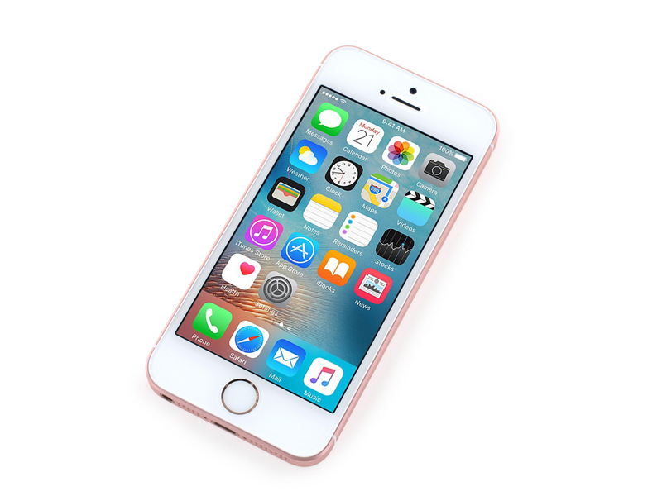
Cost and Money Value
Data
Benefits
Present data, information, and comparison to show the monetary value your product or service brings to your audience.
Convincing your prospects first with all the benefits and opportunities before revealing the price will speak directly to their pockets and price won’t be as much of an issue.
Value
$XX [Reveal the price of your product]
Deals
Remind them how much value they are getting out of this product that makes it worth more than the price.
Sell your audience on any special deals, discounts, or rates.

Slide 13
Closing / Call to Action
Recap the value of your product or service, and why it’s the superior solution.
Ask for their business with a call to action. Offer the best reason why now is the right time for them to buy your product or service.
Let the audience know what next steps are in your sales process. Thank your audience for their time.

